Slide 1
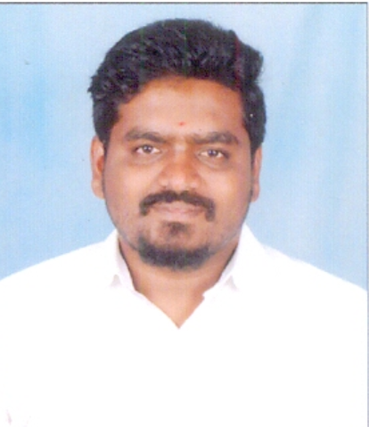
Senior Software Engineer
Photo
Expertise / Skills / Technologies
Role: Application support Total Experience: 11+ years Location : Hyderabad, India
HTML5, CSS, Javascript
AWS (EC2, RDS, ELBs, S3 and IAM )
DevOps(Ansible, Git, Maven, Basic Python, Kubernetes)
MySql, Mongo DB, PostgreSQL
Visual studio code, Git (Source code Management)
WEBLOGIC, TOMCAT, JBOSS, APACHE,
Professional Background
Selected Experiences / Projects
Having 11+ years of Extensive experience in in IT industry with specialization in Middleware, Cloud Migration and Support activities..
Experience in migrating the applications from on premises to AWS Cloud.
Involved in designing and deploying a multitude applications utilizing almost all the AWS stack (Including EC2, Route53, S3, RDS, Dynamo DB, SNS, SQS, IAM) focusing on high-availability, fault tolerance, and auto-scaling in AWS Cloud formation
Strong problem solving and debugging skills with excellent understanding of System Development Methodologies and Techniques.
Having experience with the tools like Service-Now, BMC, Visual VM, LDAP, New-Relic, Git-hub and etc
Good experience on Production and NON –production Support in 24/7 environment.
Good in communicating with the clients.
Experience in troubleshoot issues such as Out of Memory, CPU Usage, Disk Space, hung Thread sessions, JVM Crashes etc
Fixing the bugs that are found in the application, Post production support for production rollout & enhancements.
Maintaining the SLA and direct contact with customer for their Assistance.
Supporting the users in accessing the application
Design and build Database management web application that enable users to connect and control data on different databases available in the network.
Experience in working on Amazon web services like Kubernetes, S3 bucket, DynamoDB, EC2
Worked on Database: MySQL, DynamoDB
Managed Code review sessions to ensure best practices and procedures are implemented.

